Slide 1

Introduction to Tax Laws

Slide 2
Learning Objective
Describe the terminology associated with direct taxation.

Slide 3
INCOME TAX ACT 1961
Notes:
The levy of income tax in India is governed by the income tax act 1961.
It came into force 1st April 1962.
It contains 298 chapters and 14 schedules.
And a section may have a sub- sections, clauses and sub- clauses.

Slide 4
Budget 2018 highlight.doc
Notes:
The levy of income tax in India is governed by the income tax act 1961.
It came into force 1st April 1962.
It contains 298 chapters and 14 schedules.
And a section may have a sub- sections, clauses and sub- clauses.

Slide 5
Types of Taxes
Direct tax
Indirect tax

Slide 6
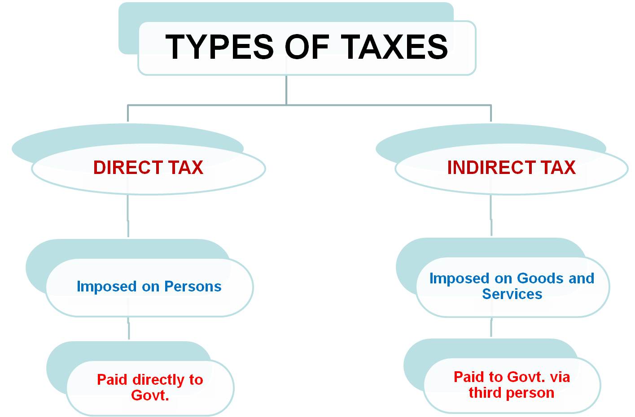

Slide 7

Meaning of Income Tax
Tax which is levied on Income earned by a Person during Previous Year at prescribed Tax Slab Rates by Central Govt. as per 7th Schedule to the Article 246 of Constitution of India.
Notes:
Levied as per the Constitution: 7th Schedule to the Article 246 of Constitution of India- List I Union List, State List, Concurrent List (Give only overview, for explanation refer text book, page no.1.4)
Definition includes the basic concepts such as Income, Person, Previous year etc. So these are explained in the next slides in detail.

Slide 8
Basic concepts
Agricultural income [Sec. 2(1A)]
Agricultural income: Agricultural incomes are fully exempted from income tax u/s 10(1). It is the Income-
Which is generated from land
Land must be situated in India and
It must have been used for agricultural purpose.
Notes:
Agricultural income: Agricultural incomes are fully exempted from income tax u/s 10(1). It is the Income-
Which is generated from land
Land must be situated in India and
It must have been used for agricultural purpose.
Definition of ‘Assessee’ – Section 2(7) of Income Tax
As per S. 2(7) of the Income Tax Act, 1961, unless the context otherwise requires, the term “assessee” means a person by whom any tax or any other sum of money is payable under this Act, and includes-
(a) every person in respect of whom any proceeding under this Act has been taken for the assessment of his income or assessment of fringe benefits or of the income of any other person in respect of which he is assessable, or of the loss sustained by him or by such other person, or of the amount of refund due to him or to such other person;
(b) every person who is deemed to be an assessee under any provision of this Act;
(c) every person who is deemed to be an assessee in default under any provision of this Act.
Block of assets: A group of assets which are similar in nature, having same rate of depreciation.

Slide 9
Basic concepts
Definition of ‘Assessee’ – Section 2(7) of Income Tax
As per S. 2(7) of the Income Tax Act, 1961, unless the context otherwise requires, the term “assessee” means a person by whom any tax or any other sum of money is payable under this Act, and includes-
(a) every person in respect of whom any proceeding under this Act has been taken for the assessment of his income
(b) every person who is deemed to be an assessee under any provision of this Act;
(c) every person who is deemed to be an assessee in default under any provision of this Act.
Notes:
Agricultural income: Agricultural incomes are fully exempted from income tax u/s 10(1). It is the Income-
Which is generated from land
Land must be situated in India and
It must have been used for agricultural purpose.
Definition of ‘Assessee’ – Section 2(7) of Income Tax
As per S. 2(7) of the Income Tax Act, 1961, unless the context otherwise requires, the term “assessee” means a person by whom any tax or any other sum of money is payable under this Act, and includes-
(a) every person in respect of whom any proceeding under this Act has been taken for the assessment of his income or assessment of fringe benefits or of the income of any other person in respect of which he is assessable, or of the loss sustained by him or by such other person, or of the amount of refund due to him or to such other person;
(b) every person who is deemed to be an assessee under any provision of this Act;
(c) every person who is deemed to be an assessee in default under any provision of this Act.
Block of assets: A group of assets which are similar in nature, having same rate of depreciation.

Slide 10
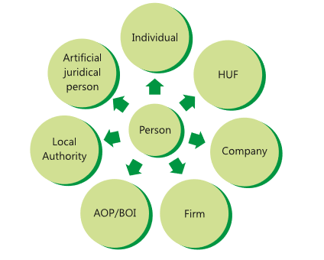
Cont…
Person [Sec. 2(31)]
Notes:
Person [Section 2(31)] : Definition under I.Tax
Person includes :
an Individual;
a Hindu Undivided Family (HUF) ;
a Company;
a Firm
an association of persons or a body of individuals, whether incorporated or not;
a local authority; and
every artificial juridical person not falling within any of the preceding sub-clauses.
Association of Persons or Body of Individuals or a Local authority or Artificial Juridical Persons shall be deemed to be a person whether or not, such persons are formed or established or incorporated with the object of deriving profits or gains or income.
The word person is a very wide term and embraces in itself the following :
Individual. It refers to a natural human being whether male or female, minor or major.
Hindu Undivided Family. It is a relationship created due to operation of Hindu Law. The manager of HUF is called “Karta” and its members are called ‘Coparceners’.
Company. It is an artificial person registered under Indian Companies Act 1956 or any other law.
Firm. It is an entity which comes into existence as a result of partnership agreement between persons to share profits of the business carried on by all or any one of them. Though, a partnership firm does not have a separate legal entity, yet it has been regarded as a separate entity under Income Tax Act. Under Income Tax Act, 1961, a partnership firm can be of the following two types
a firm which fulfil the conditions prescribed u/s 184.
A firm which does not fulfil the conditions prescribed u/s 184.
It is important to note that for Income Tax purposes, a limited liability partnership (LLP) constituted under the LLP Act, 2008 is also treated as a firm.
5. Association of Persons or Body of Individuals.: Co-operative societies, MARKFED, NAFED etc. are the examples of such persons. When persons combine togather to carry on a joint enterprise and they do not constitute partnership under the ambit of law, they are assessable as an association of persons. Receiving income jointly is not the only feature of an association of persons. There must be common purpose, and common action to achieve common purpose i.e. to earn income. An AOP. can have firms, companies, associations and individuals as its members.
A body of individuals (BOl) cannot have non-individuals as its members. Only natural human beings can be members of a body of individuals.
Whether a particular group is AOP. or BOl. is a question of fact to be decided in each case separately.
6. Local Authority. Municipality, Panchayat, Cantonment Board, Port Trust etc. are called local authorities.
7. Artificial Juridical Person. A public corporation established under special Act of legislature and a body having juristic personality of its own are known to be Artificial Juridical Persons. Universities are an important example of this category.
Example :
Determine the status of following persons :
Reliance Industries Limited. [ company. ]
Punjab National Bank. [ company. ]
Madras University. [ Artificial Juridical person]
Calcutta Municipal Corporation. [ Local Authority]
A partnership firm with A, B and C partners. [ Firm]
A Brahmin Parivar consisting of Mr. A, his brother B, Mrs. A and B. [ H.U.F.]
Kalyani Publishers Ltd. [ Company]
Reserve Bank of India. [ Artifitial Judicial Person]
Life Insurance Corporation of India. [ Company]
Mr. Narendra Modi, Prime Minister of India. [ Individual]
A Village Panchyat. [ Local Authority]
Markfed, Housefed. [ Association of Person - AOP ]
​​​HINDU UNDIVIDED FAMILY (HUF)
​Hindu Undivided Family (‘HUF’) is treated as a ‘person’ under section 2(31)​ of the Income-tax Act, 1961 (herein after referred to as ‘the Act’). HUF is a separate entity for the purpose of assessment under the Act.
Under Hindu Law, an HUF is a family which consists of all persons lineally descended from a common ancestor and includes their wives and unmarried daughters. An HUF cannot be created under a contract, it is created automatically in a Hindu Family.
Jain and Sikh families even though are not governed by the Hindu Law, but they are treated as HUF under the Act.
Assessment of HUF :-
An HUF is recognized as a separate assessable entity under the Act. Its income may be assessed if following two conditions are satisfied:
There should be a coparcenership. In this connection, it is worthwhile to mention that once a joint family income is assessed as that of HUF, it continues to be assessed as such in subsequent assessment years till partition is claimed by coparceners.
There should be a joint family property which consists of ancestral property, property acquired with the aid of ancestral property and property transferred by its members.
Ancestral Property: Ancestral property may be defined as the property which a man inherits from any of his three immediate male ancestors, i.e. his father, grandfather and great grandfather. Therefore, property inherited from any other relation is not treated as ancestral property. Income from ancestral property held by following families is taxable as income of HUF:
a) A family of widow mother and sons (may be minor or major) ;
b) Family of husband and wife, having no child ;
c) Family of two widows of deceased brothers ;
d) Family of two or more brothers ;
e) Family of uncle and nephew ;
f) Family of mother, son and son’s wife ;
g) Family of a male and his late brother’s wife.
Note
Property obtained by daughter from joint family property would be her absolute property. Any income therefrom is chargeable to tax in her hands in the individual status only. This will also apply to any legal heir obtaining property in the capacity of a descendent.

Slide 11
Determine the status of following Persons:
Reliance Industries Limited
Punjab National Bank
Madras University
Calcutta Municipal Corporation
A Partnership Firm with A, B and C partners.
A Brahmin Parivar consisting of Mr. A, his brother B, Mrs. A and B.

Slide 12
Kalyani Publishers Ltd.
Reserve Bank of India.
Life Insurance Corporation of India.
Mr. Narendra Modi, Prime Minister of India.
A Village Panchyat
Mr Nirmal Ltd

Slide 13
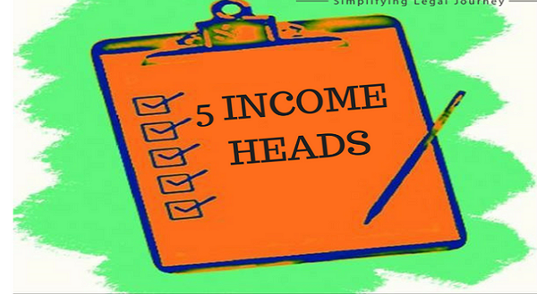
Cont…
Heads of Income
Gross Total Income [Sec. 80B(5)]
Total income [Sec. 2(45)]
Notes:
Heads of Income= Salary, House Property, Capital Gain, Business Income, Other sources
Gross Total Income (GTI)= Sum total of income from 5 heads
Total income (TI)= Gross Total Income – Deductions u/s 80

Slide 14
Gross Total Income [Sec. 80B(5)]
Gross Total Income is a cumulative income which is computed under the five heads of income, i.e. salary, house property, business or profession, capital gain and other sources.
Gross total income is calculated after the clubbing provisions and making adjustments of set-off and carry forward of losses
Notes:
Heads of Income= Salary, House Property, Capital Gain, Business Income, Other sources
Gross Total Income (GTI)= Sum total of income from 5 heads
Total income (TI)= Gross Total Income – Deductions u/s 80

Slide 15
Total income [Sec. 2(45)]
" total income" means the total amount of income referred to in section 5, computed in the manner laid down in this Act;
Notes:
Income Tax Section 5 – Scope of total Income
(1) Subject to the provisions of this Act, the total income of any previous year of a person who is a resident includes all income from whatever source derived which-
(a) is received or is deemed to be received in India in such year by or on behalf of such person ; or
(b) accrues or arises or is deemed to accrue or arise to him in India during such year ; or
(c) accrues or arises to him outside India during such year :
Provided that, in the case of a person not ordinarily resident in India within the meaning of sub-section (6) of section 6, the income which accrues or arises to him outside India shall not be so included unless it is derived from a business controlled in or a profession set up in India.
(2) Subject to the provisions of this Act, the total income of any previous year of a person who is a non-resident includes all income from whatever source derived which—
(a) is received or is deemed to be received in India in such year by or on behalf of such person ; or
(b) accrues or arises or is deemed to accrue or arise to him in India during such year.
Explanations
1. Income accruing or arising outside India shall not be deemed to be received in India within the meaning of this section by reason only of the fact that it is taken into account in a balance sheet prepared in India.
2. For the removal of doubts, it is hereby declared that income which has been included in the total income of a person on the basis that it has accrued or arisen or is deemed to have accrued or arisen to him shall not again be so included on the basis that it is received or deemed to be received by him in India.

Slide 16

Assessment year [Sec. 2(9)]
Previous year [Sec. 2(34)]
Notes:
ASSESSMENT YEAR [Section 2(9)]
This is a period of 12 months commencing on the 1st April every year.
A year in which income earned is the previous year, and such income is taxable in the immediately following year called Assessment year.
PREVIOUS YEAR []
Its means the financial year immediately preceding the assessment year.
The income earned in the pervious year is taxable in the assessment year.
If, business and profession is newly set up during the financial year – in such a case, the previous year shall be the period beginning on the date of setting up the business or profession and ending with 31st march of the financial year.

Slide 17
If, business and profession is newly set up during the financial year –
in such a case, the previous year shall be the period beginning on the date of setting up the business or profession and ending with 31st march of the financial year.
Notes:
ASSESSMENT YEAR [Section 2(9)]
This is a period of 12 months commencing on the 1st April every year.
A year in which income earned is the previous year, and such income is taxable in the immediately following year called Assessment year.
PREVIOUS YEAR []
Its means the financial year immediately preceding the assessment year.
The income earned in the pervious year is taxable in the assessment year.
If, business and profession is newly set up during the financial year – in such a case, the previous year shall be the period beginning on the date of setting up the business or profession and ending with 31st march of the financial year.

Slide 18
example
X starts a new business on January 29, 2017. He closes down first set of books of accounts on March 31, 2018.
He wants the income generated during this period should be chargeable to tax for the assessment year 2018-19. Is he legally correct?

Slide 19
Rates of taxes
Assessment Year 2019-20

Slide 20

TAX SLABS 2019-20
Individual (Resident or Non-Resident), who is of the age of less than 60 years on the last day of the relevant previous year:
Income | Tax rates
Income up to 2,50,000 | No tax
Income from 2,50,000 to 5,00,000 | 5% of taxable income
Income from 5,00,000 to 10,00,000 | 12500+ 20%of income above 500,000
Income above 10,00,000 | 1,12,500 +30% of income above 10,00,000

Slide 21
Resident Senior Citizen, i.e., every individual, being a resident in India, who is of the age of 60 years or more but less than 80 years at any time during the previous year:
Income | Tax rates
Income up to 3,00,000 | No tax
Income from 3,00,000 to 5,00,000 | 5% of taxable income
Income from 5,00,000 to 10,00,000 | 10000+ 20%of income above 500,000
Income above 10,00,000 | 1,10,000 +30% of income above 10,00,000

Slide 22
Resident Super Senior Citizen, i.e., every individual, being a resident in India, who is of the age of 80 years or more at any time during the previous year:
Income | Tax rates
Income up to 5,00,000 | No tax
Income from 5,00,000 to 10,00,000 | 20%
Income above 10,00,000 | 30%

Slide 23
Plus:
Surcharge: 10% of tax where total income exceeds Rs. 50 lakh
15% of tax where total income exceeds Rs. 1 crore
Health and Education Cess: “Education Cess” and “Secondary and Higher Education Cess” will be replaced by “Health and Education Cess” at the rate of 4%, on the amount of tax computed, inclusive of surcharge.
Note: A resident individual is entitled for rebate u/s 87A if his total income does not exceed Rs. 3,50,000. The amount of rebate shall be 100% of income-tax or Rs. 2,500, whichever is less.

Slide 24
MCQs

Slide 25
Income Tax Act came into force on ...................
A. 01.04.1961
B. 01.04.1962
C. 01.04.1956
D. 01.04.1965
Notes:
Answer: B. 01.04.1962

Slide 26
How many heads of income are there to compute Gross total income.
A. Six
B. Five
C. Four
D. Three
Notes:
B. Five

Slide 27
Income by way of rent of agricultural land is ..............
A. Business income
B. Income from other sources
C. Agricultural income
D. Casual income
Notes:
C. Agricultural income

Slide 28
The highest Administrative Authority for Income Tax in India is............
A. Finance Minister
B. CBDT
C. President of India
D. Director of Income Tax.
Notes:
B. CBDT

Slide 29


